Slide 1


Predictive Modeling for Alzheimer's Disease Stages
Utilizing MRI Image Data for Accurate Stage Prediction
Presented by: Shaikh Mijan Ur Rahman

Slide 2
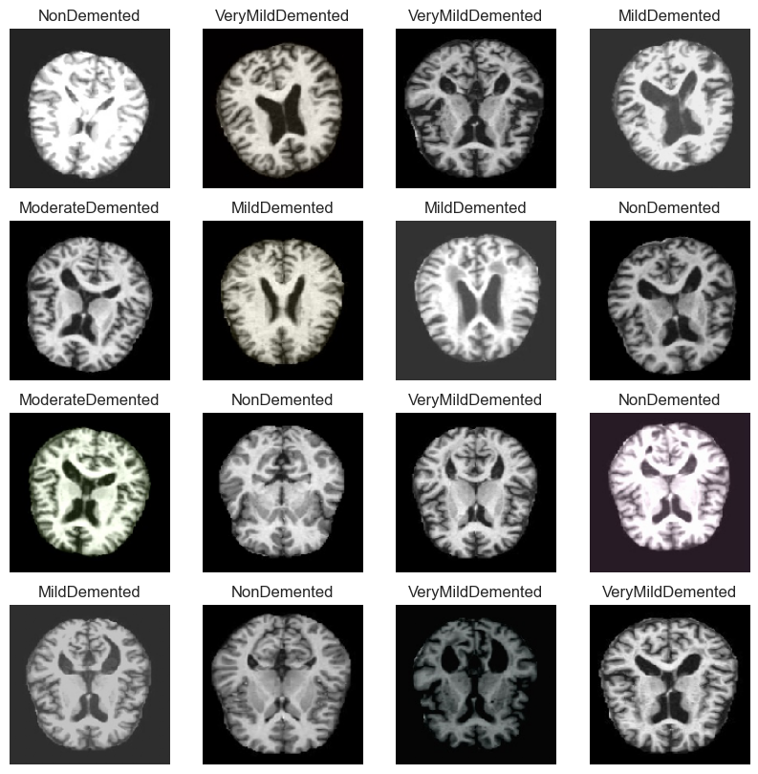
Image sample
Primary Data: https://data.mendeley.com/datasets/ch87yswbz4/1
Secondary Data: https://www.kaggle.com/datasets/tourist55/alzheimers-dataset-4-class-ofimages

Slide 3
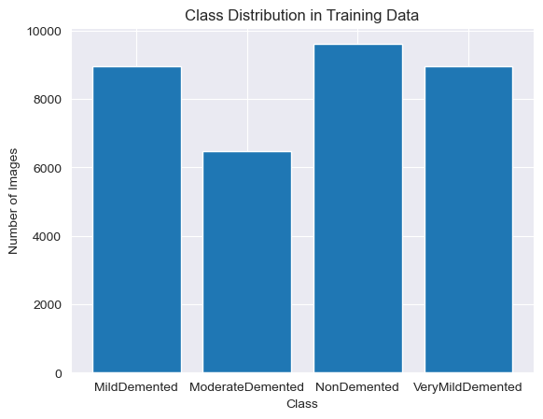
Data Distribution
Mild Demented
Moderate Demented
Non Demented
Very Mild Demented

Slide 4
Libraries and
Tools
Used
Data Handling & Visualization:
Pandas, NumPy: Data manipulation and numerical computations.
Matplotlib, Seaborn: Visualization
Deep Learning Framework:
TensorFlow & Keras:
Layers: Dense, Flatten, Conv2D, MaxPooling2D, BatchNormalization, Dropout.
Pre-trained Model: VGG16 for transfer learning.
Optimizer: Adam.
Callbacks: ModelCheckpoint, EarlyStopping, ReduceLROnPlateau.
Data Augmentation:
ImageDataGenerator.
Evaluation Metrics:
Confusion Matrix, Classification Report.
Additional Tools:
os, collections.Counter.

Slide 5
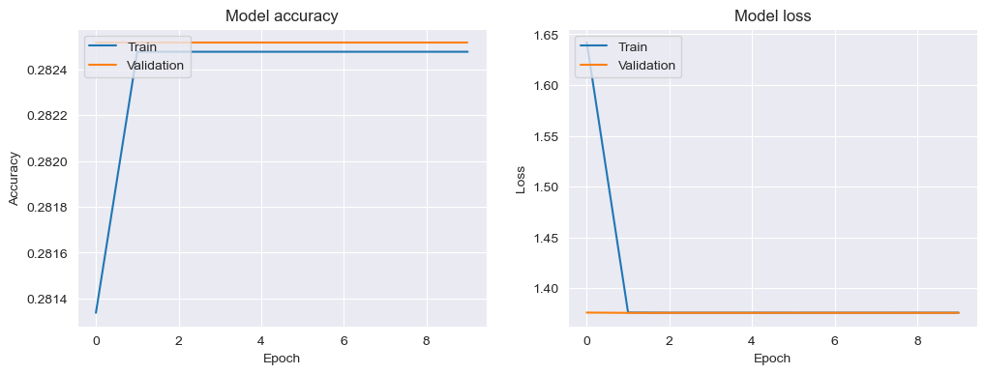
Attempt 1

Slide 6
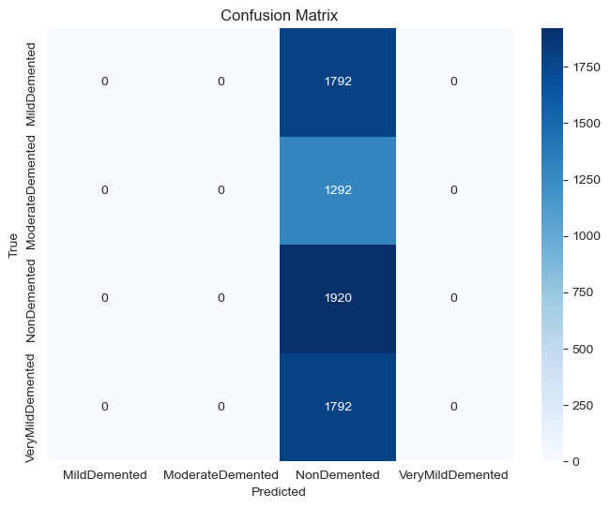
Attempt 1
Modal name = Modal
Modal name = Modal
Architecture:
Conv Block 1: 16 filters, 3x3 kernel, ReLU, BatchNorm, MaxPooling
Conv Block 2: 32 filters, 3x3 kernel, ReLU, BatchNorm, MaxPooling
Dense Layer: 128 units, ReLU, Dropout (0.5)
Output: 4 classes, softmax
Training:
Optimizer: Adam
Loss: Categorical Crossentropy
Metrics: Accuracy
Epochs: 10
Batch Size: 64
Callbacks:
ModelCheckpoint (save best model)

Slide 7
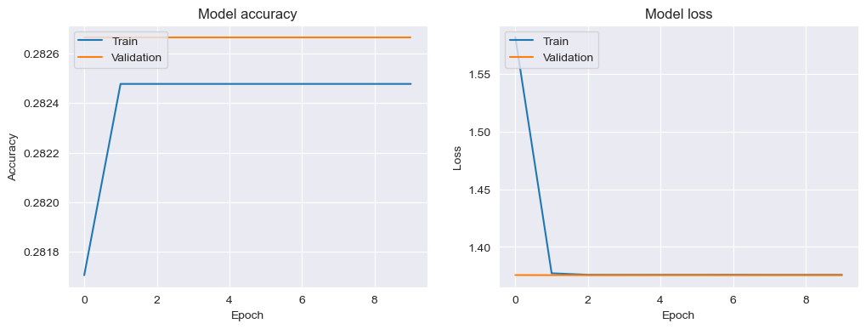
Attempt 2

Slide 8

Attempt 2
Modal name = Modal1
Architecture:
Conv Block 1: 32 filters, 3x3 kernel, ReLU, BatchNorm, MaxPooling
Conv Block 2: 64 filters, 3x3 kernel, ReLU, BatchNorm, MaxPooling
Dense Layer: 64 units, ReLU, Dropout (0.5)
Output Layer: 4 classes, softmax
Training:
Optimizer: Adam
Loss: Categorical Crossentropy
Metrics: Accuracy
Epochs: 10
Batch Size: 64
Callbacks:
ModelCheckpoint (save best model)

Slide 9
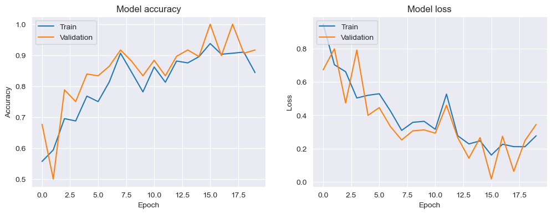
Attempt 3

Slide 10
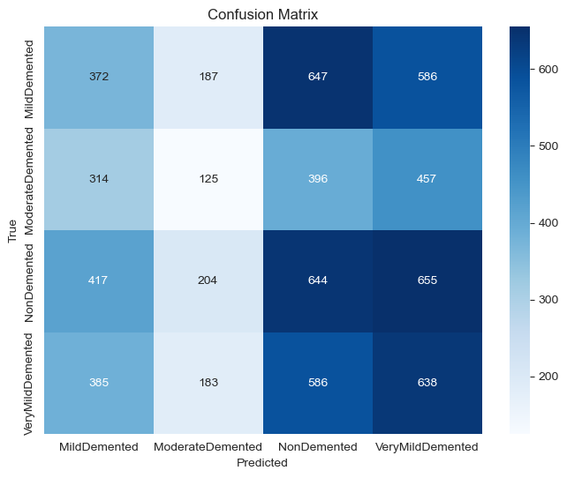
Attempt 3
Modal name = Modal2
Architecture:
Conv Block 1: 32 filters, 3x3 kernel, ReLU, MaxPooling
Conv Block 2: 64 filters, 3x3 kernel, ReLU, MaxPooling
Conv Block 3: 128 filters, 3x3 kernel, ReLU, MaxPooling
Dense Layer: 128 units, ReLU, Dropout (0.5)
Output Layer: 4 classes, softmax
Training:
Optimizer: Adam (learning rate = 0.001)
Loss: Categorical Crossentropy
Metrics: Accuracy
Epochs: 20
Batch Size: Based on generator
Callbacks:
ModelCheckpoint (save best model based on validation accuracy)

Slide 11
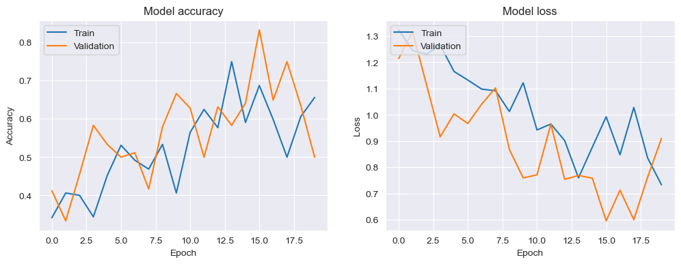
Attempt 4

Slide 12
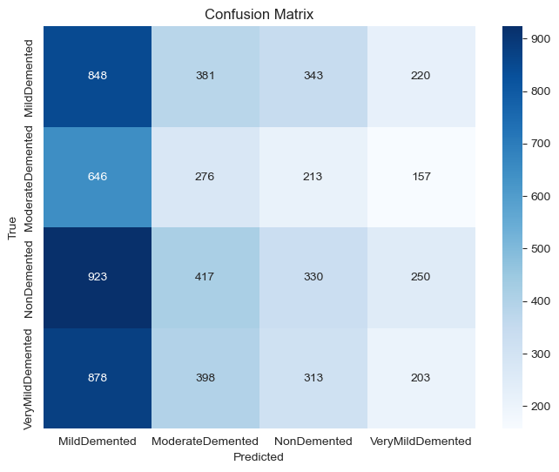
Attempt 4
Modal name = Modal3
Augmentation Techniques:
Rescale: 1./255
Rotation: 20°
Width/Height Shift: 20%
Shear: 20%
Horizontal Flip
Fill Mode: Nearest
Zoom: 20%
Validation Split: 20%

Slide 13
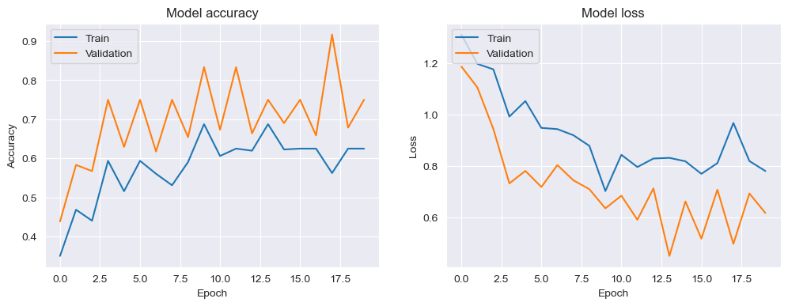
Attempt 5

Slide 14
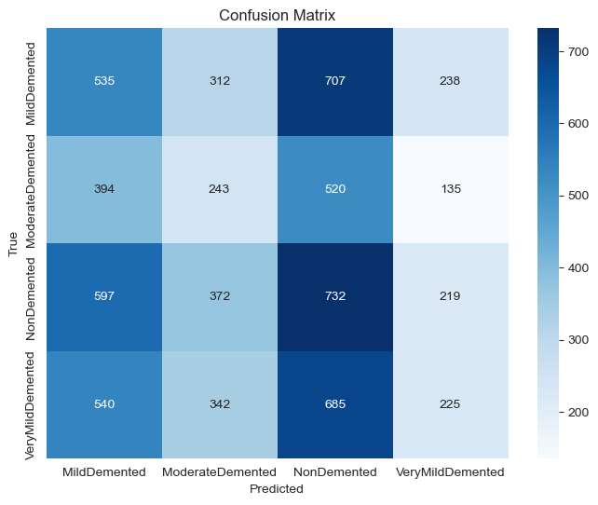
Attempt 5
Modal name = Modal4
Architecture:
Conv Block 1: 32 filters, 3x3 kernel, ReLU, MaxPooling
Conv Block 2: 64 filters, 3x3 kernel, ReLU, MaxPooling
Conv Block 3: 128 filters, 3x3 kernel, ReLU, MaxPooling
Dense Layer: 128 units, ReLU, Dropout (0.5)
Output Layer: 4 classes, softmax
Training:
Optimizer: RMSprop
Loss: Categorical Crossentropy
Metrics: Accuracy
Epochs: 20
Batch Size: Based on generator
Callbacks:
ModelCheckpoint (save best model based on validation accuracy)

Slide 15
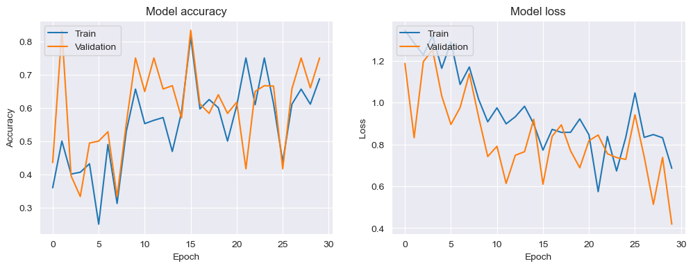
Attempt 6

Slide 16
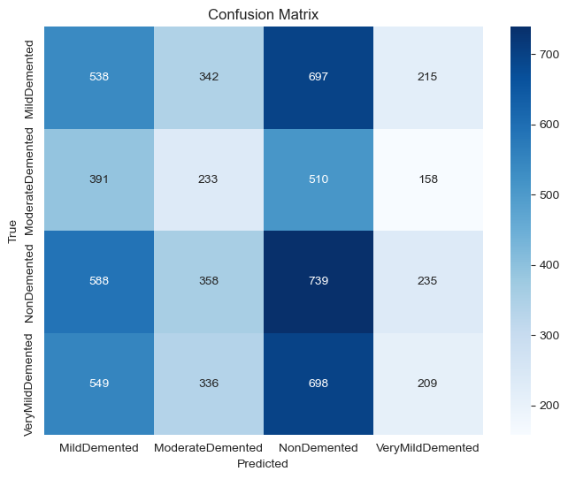
Attempt 6
Modal name = Modal5
Architecture:
Conv Block 1: 32 filters, 3x3 kernel, ReLU, BatchNorm, MaxPooling
Conv Block 2: 64 filters, 3x3 kernel, ReLU, BatchNorm, MaxPooling
Conv Block 3: 128 filters, 3x3 kernel, ReLU, BatchNorm, MaxPooling
Conv Block 4: 256 filters, 3x3 kernel, ReLU, BatchNorm, MaxPooling
Dense Layer: 256 units, ReLU, Dropout (0.5)
Output Layer: 4 classes, softmax
Training:
Optimizer: Adam (learning rate = 1e-4)
Loss: Categorical Crossentropy
Metrics: Accuracy
Epochs: 30
Batch Size: Based on generator
Callbacks:
ModelCheckpoint: Save best model based on validation accuracy
ReduceLROnPlateau: Reduce learning rate when validation loss plateaus

Slide 17
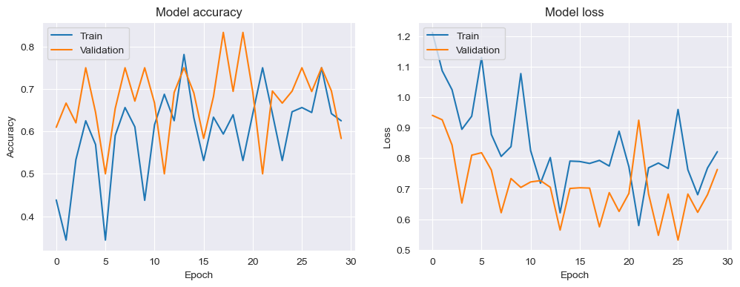
Attempt 7

Slide 18
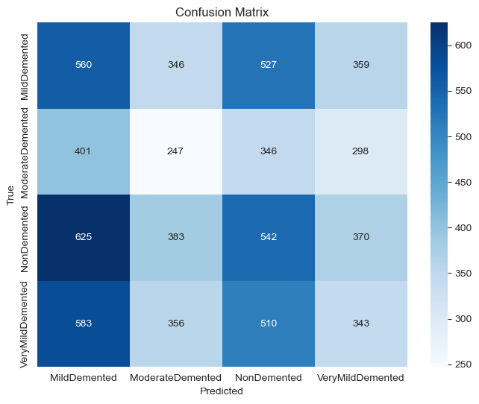
Attempt 7
Modal name = Modal6
Architecture:
Base Model: VGG16 (pre-trained, frozen layers)
Additional Layers:
  Flatten
  Dense: 256 units, ReLU
  Dropout: 0.5
  Dense: 4 units, softmax
Training:
Optimizer: Adam (learning rate = 1e-4)
Loss: Categorical Crossentropy
Metrics: Accuracy
Epochs: 30
Batch Size: Based on generator
Class Weights: Calculated and applied for balanced training
Callbacks:
ModelCheckpoint: Save best model based on validation accuracy
ReduceLROnPlateau: Adjust learning rate based on validation loss

Slide 19
http://127.0.0.1:7872

